Slide 1

Impact of covid on overseas migration to Australia
Bec, Anuja and Luz

Slide 2

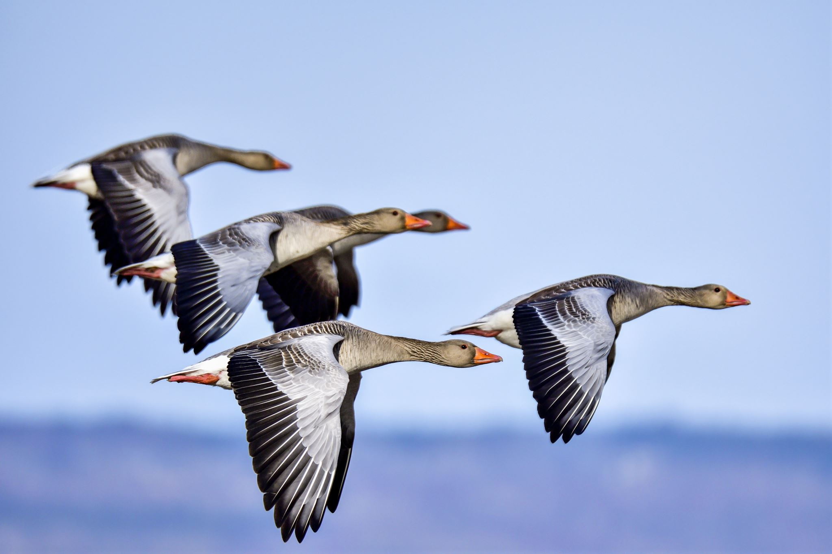
Agenda
Introduction​
Research Question
Data
Analysis

Slide 3
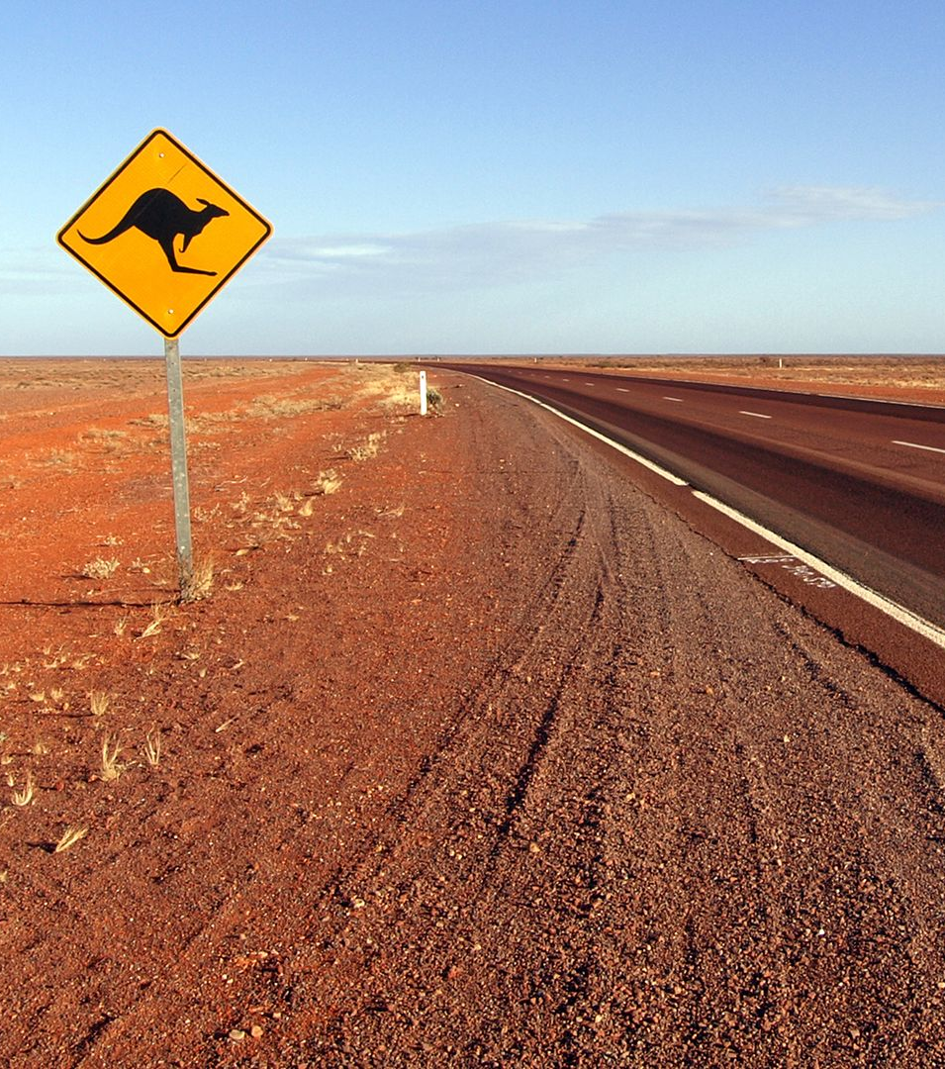

Introduction
“Australia's migrant population is expected to have grown by more than 700,000 between the 2022 and 2024 financial years.”
- ABC News

Slide 4

Research question
How has COVID affected migration
arrivals to Australia pre and post
2020, and specifically:
State / Location;
Gender;
Age;
Purpose (visa status);and
Work Hours.

Slide 5

Data
Data was obtained from the Australian Bureau of Statistics (ABS): Overseas Migration and Labour Force on a Financial Year basis.

Slide 6

Analysis

Slide 7
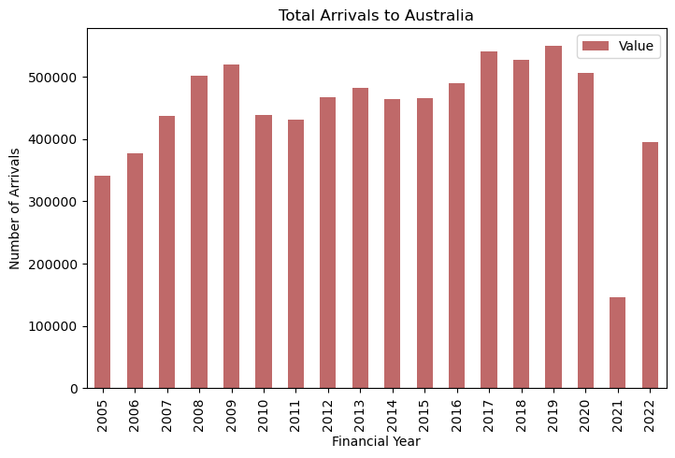
Summary of Migrant arrivals

Slide 8
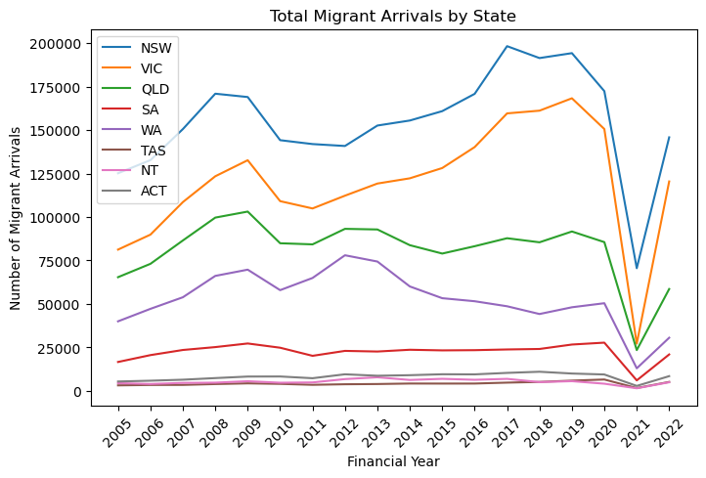
Location

Slide 9
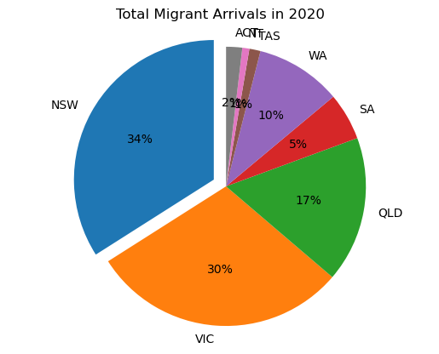
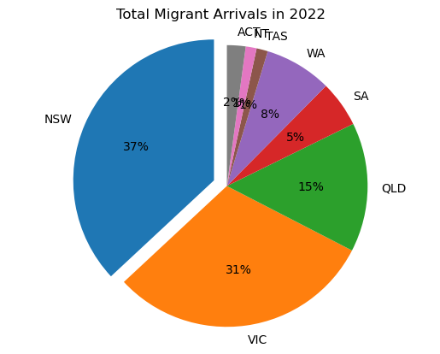
Location

Slide 10
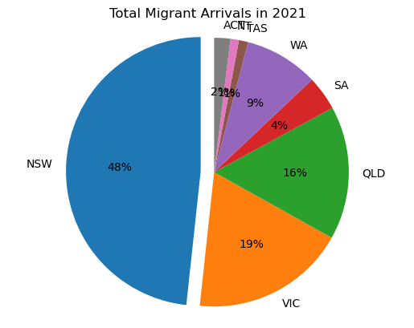
Location

Slide 11
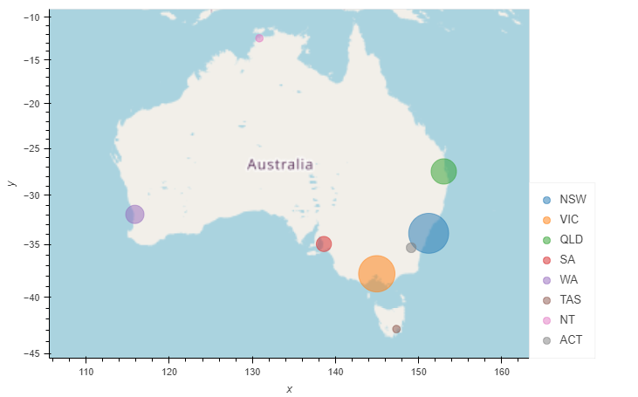
Location

Slide 12
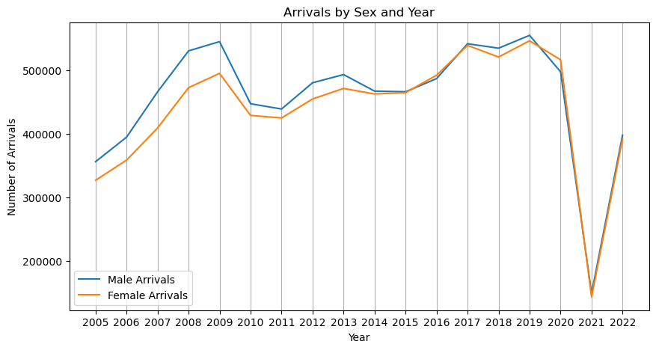
Number of arrivals by gender between 2005 and 2022

Slide 13
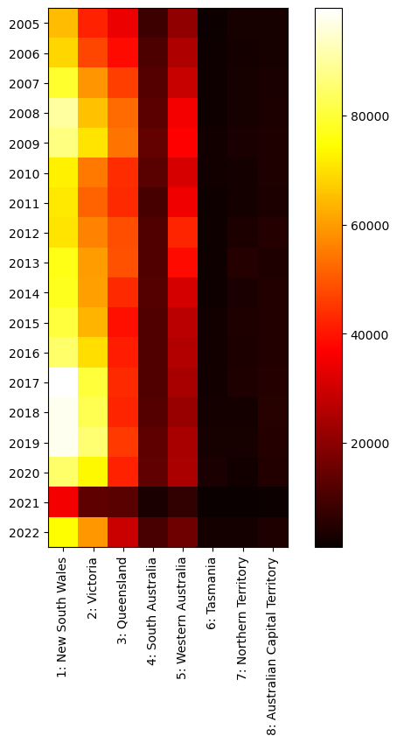

Popular states per gender:
Male
Female

Slide 14
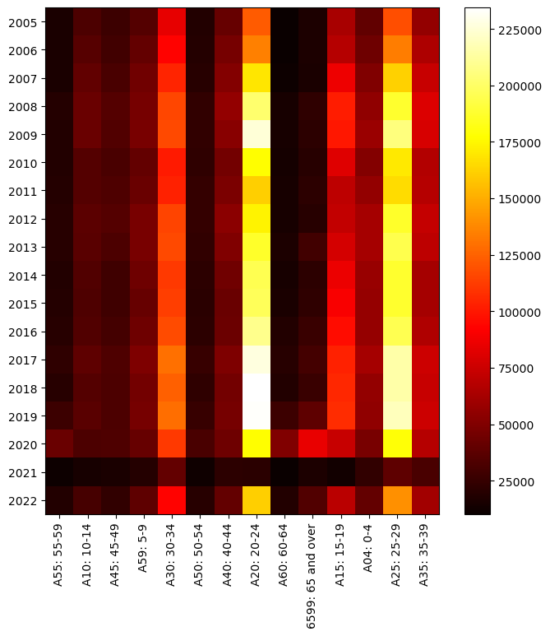
Number of people arrived based on different age brackets between 2005-2022

Slide 15
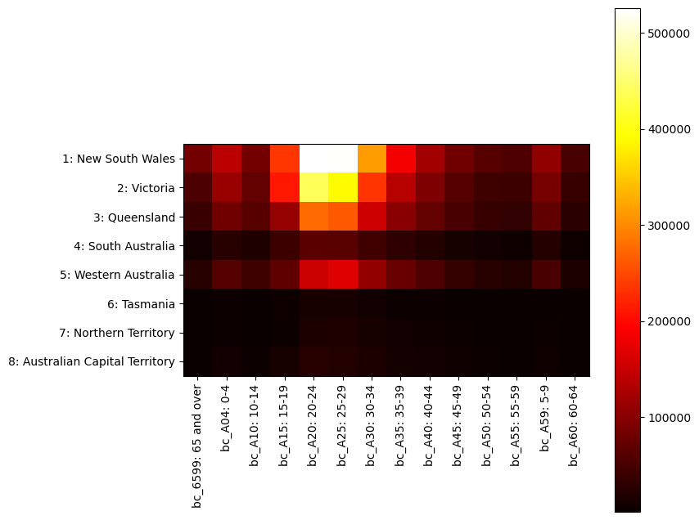
Number of people entering each state per age bracket before covid

Slide 16
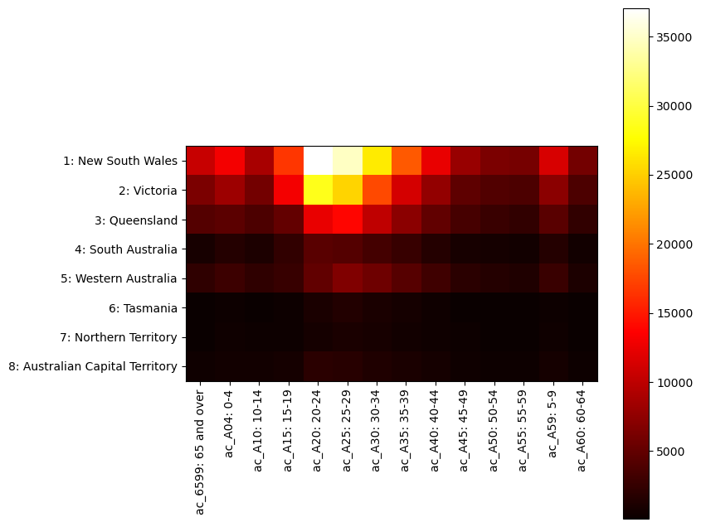
Number of people entering each state per age bracket after covid

Slide 17
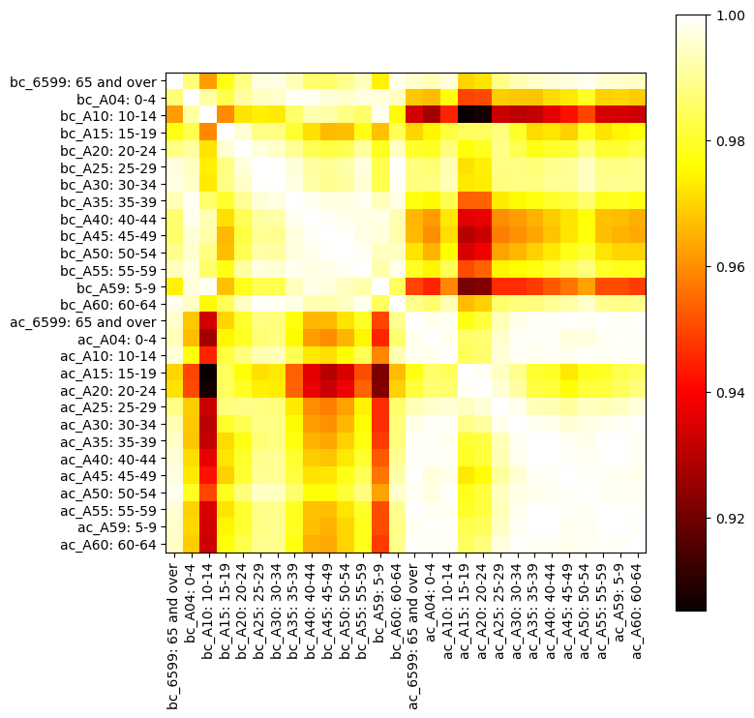
Correlation matrix to show changes between different age brackets before and after covid

Slide 18
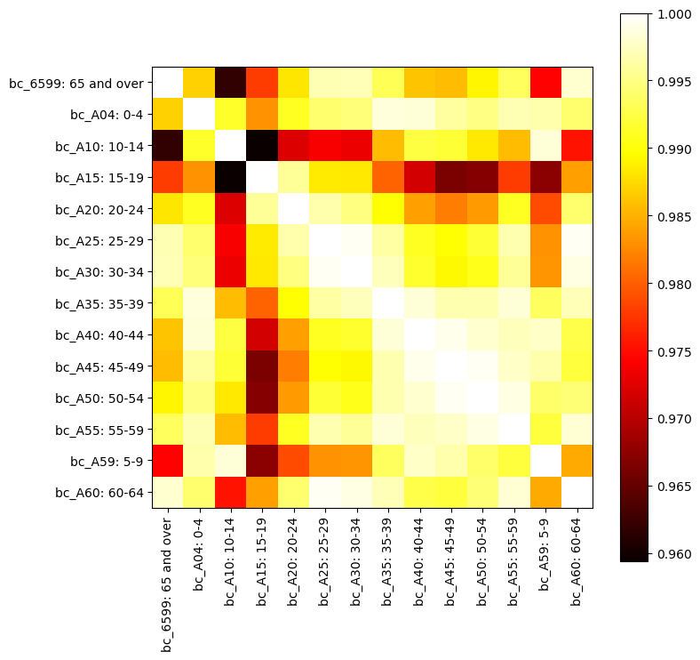
Before Covid correlation matrix between different age brackets

Slide 19
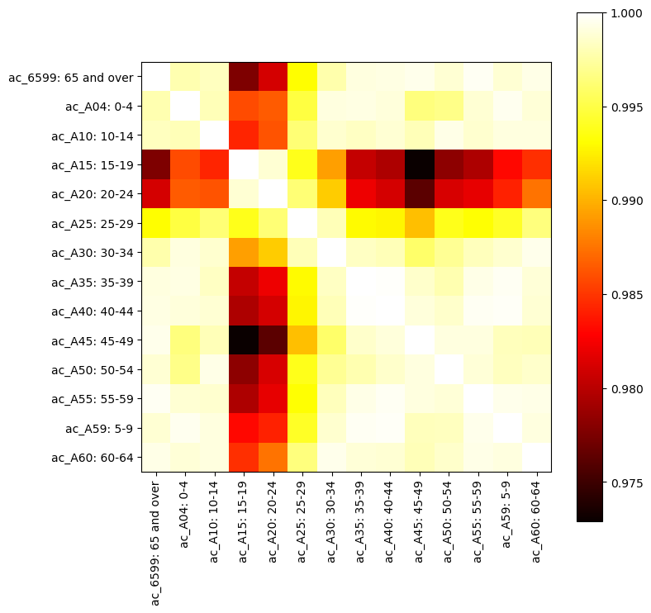
After Covid correlation matrix between different age brackets

Slide 20
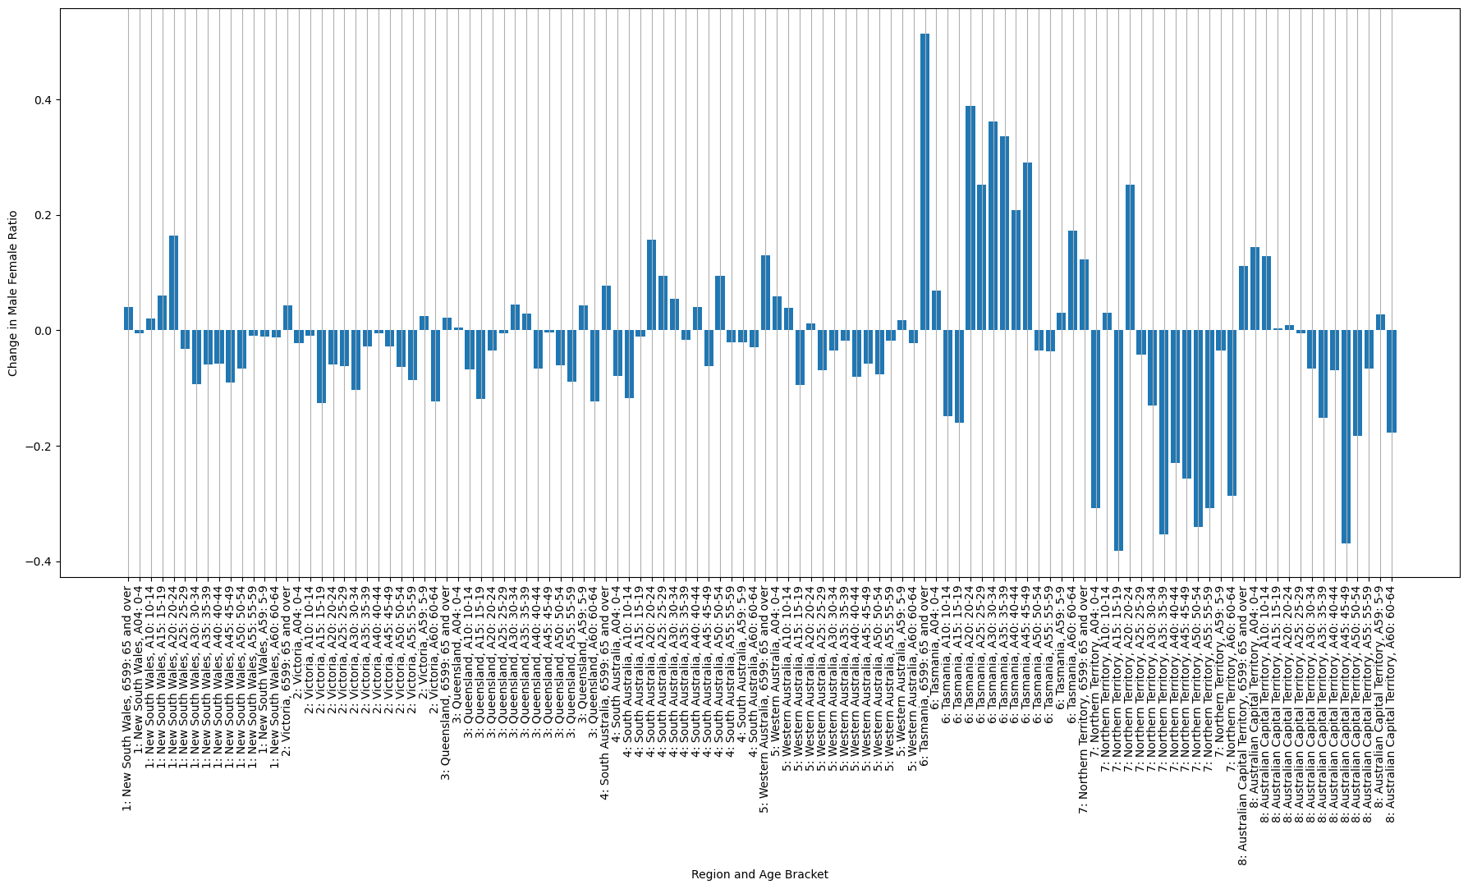
Change in ‘Male-Female Ratio’ entering each state per age category

Slide 21
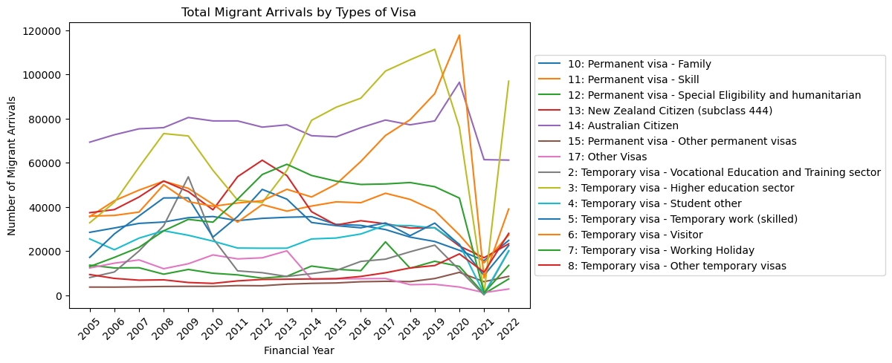
types of visa

Slide 22
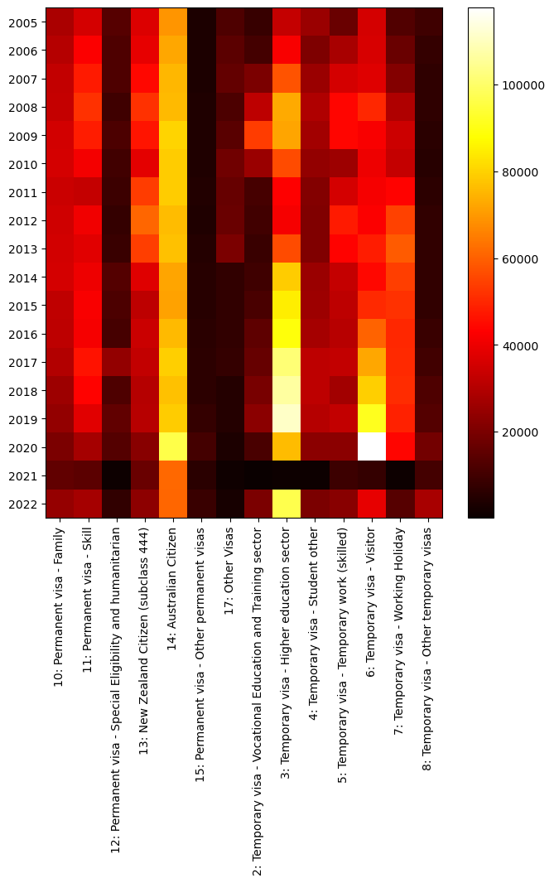
types of visa

Slide 23
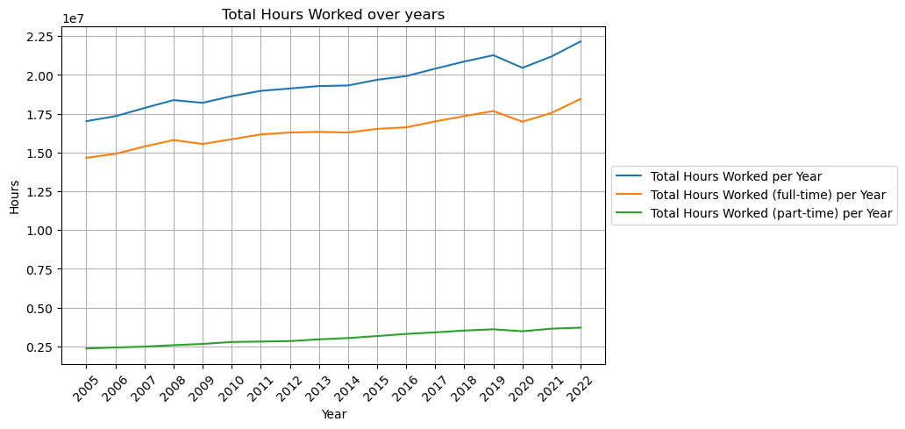
Work hours

Slide 24
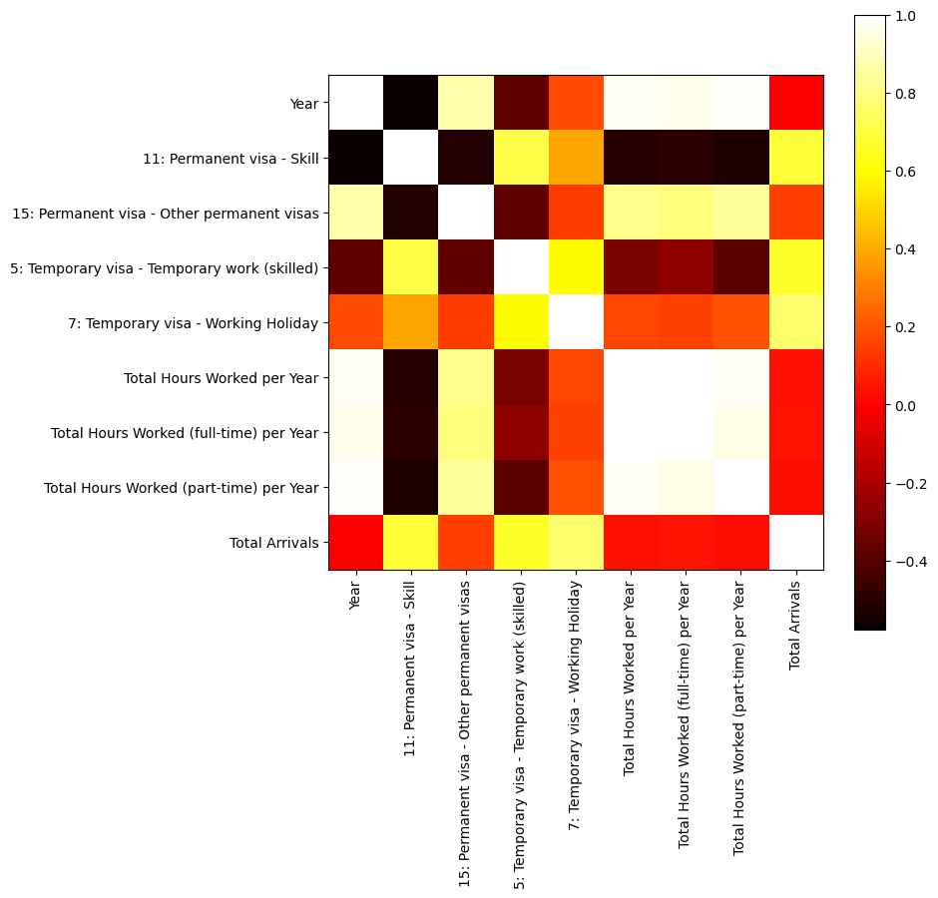
Correlation between migrant arrivals to Australia & worked hours

Slide 25
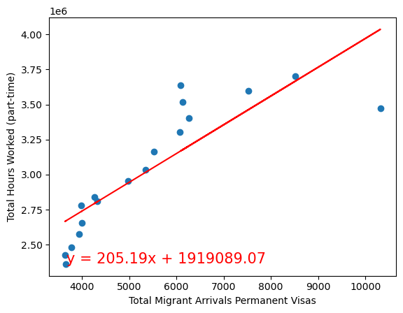

Total Hours Worked (part-time) vs. Total Migrant Arrivals Permanent Visas

Slide 26
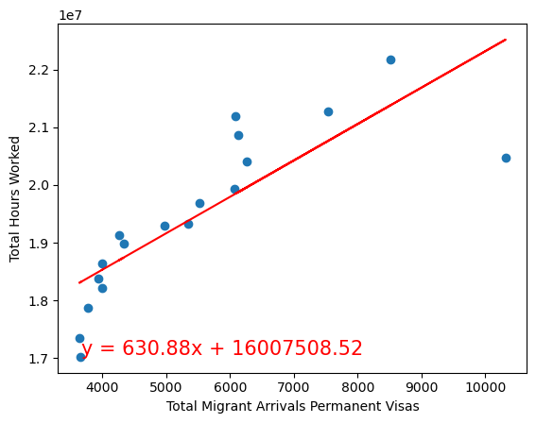

Total Hours Worked vs. Total Migrant Arrivals Permanent Visas

Slide 27
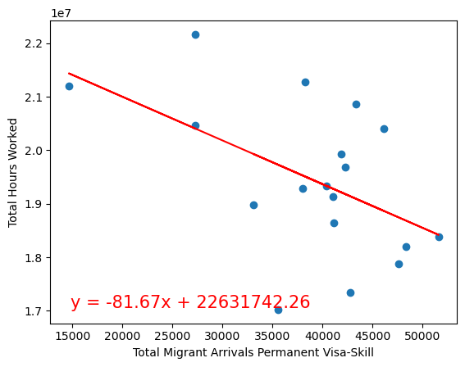

Total Hours Worked vs. Total Migrant Arrivals Permanent Visa - Skill

Slide 28
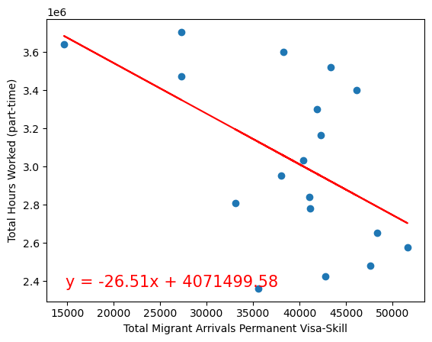

Total Hours Worked (part-time) vs. Total Migrant Arrivals Permanent Visa - Skill

Slide 29


Thank you
Bec, Anuja & Luz

